Slide 1
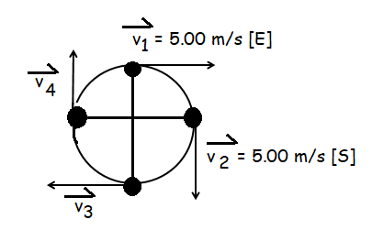
Minds on: a) A ball is being swung on the end of a string in a constant horizontal circle at a speed of 5.00 m/s. If it takes the ball 1.00 second to complete one full revolution, what is the average acceleration over ¼ of the cycle from v₁ to v₂?
Acceleration in Uniform Circular Motion
b) Using symmetry, what is the average acceleration between v₃ and v₄?

Slide 2
Minds On Analysis:

Slide 3
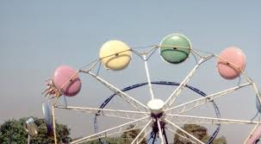
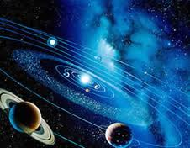
Uniform Circular Motion
Circular Coordinates

Slide 4
Uniform Circular motion occurs when an object moves in a circular path at a constant speed.
|v|=v
●
●
●
●

Slide 5
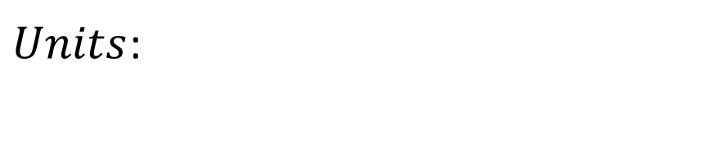
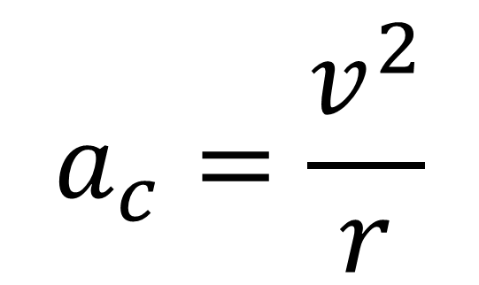
Instantaneous Acceleration Magnitude
●
$$a_{c}=\frac{v^{2}}{r}$$
●
●
$Units$:

Slide 6
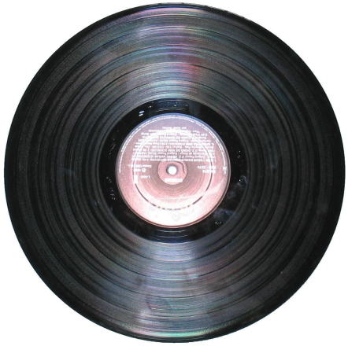
Applications:
Orbital motion
-planets about sun
-moon, satellites about Earth
Rotating Objects
-wheels, vinyl records
-amusement park rides (Windseeker!)
-spinning a bucket over your head
-washing machine, centrifuge

Slide 7
Example 1: A child on a merry go round is
3.0 m from the centre of the ride. If the child’s speed is 2.0 m/s, what is the magnitude of the child’s centripetal acceleration? (1.3 m/s² )

Slide 8
Other forms of the equation:
Given radius and period (T):
Circumference, C:
r
Period, T:
C
Speed :
We can rewrite the acceleration:

Slide 9
Given radius and frequency (f):
Frequency (f)- is the number of cycles that occur in one second. Frequency is the inverse of period.
Substituting this expression in for period:

Slide 10
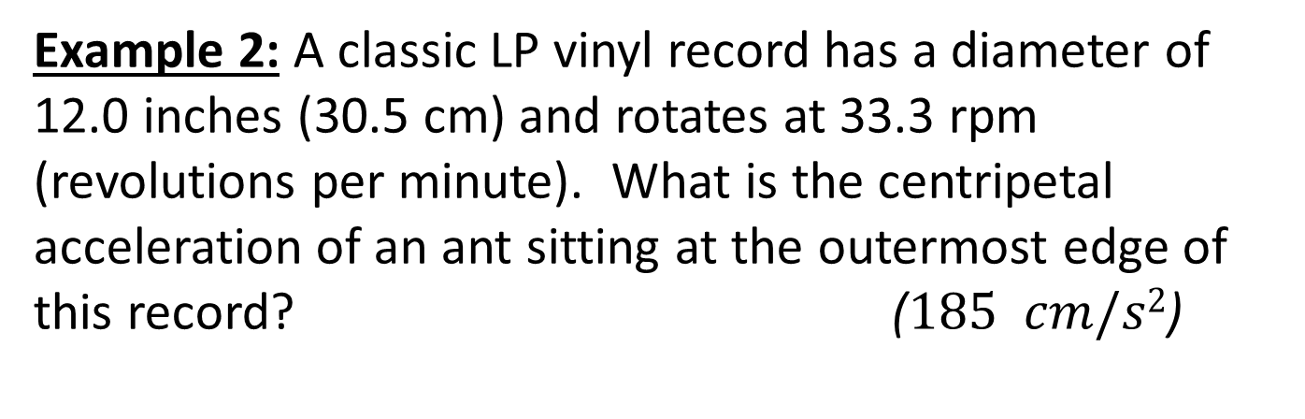
Example 2: A classic LP vinyl record has a diameter of 12.0 inches (30.5 cm) and rotates at 33.3 rpm (revolutions per minute). What is the centripetal acceleration of an ant sitting at the outermost edge of this record? ($185 cm/s2$)

Slide 11
Summary of Centripetal Acceleration:
Centripetal acceleration occurs when an object is moving in a circle at a constant ___________.
The velocity vector is constant in magnitude and always directed ___________ to the path.
The acceleration vector is constant inmagnitude and always directed _______ inwards.

